Slide 1
Neural Network Model for Concrete Strength Prediction

Slide 2
Objective
Finding the optimal number of nodes and layers in ANN model

Slide 3
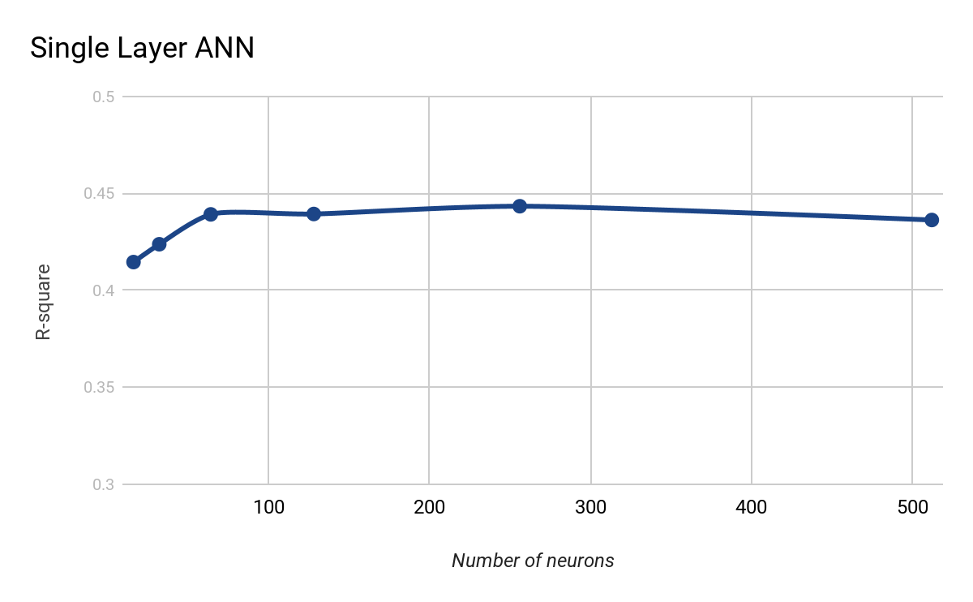
1 Hidden Layer
From 16 neurons to 512 neurons

Slide 4
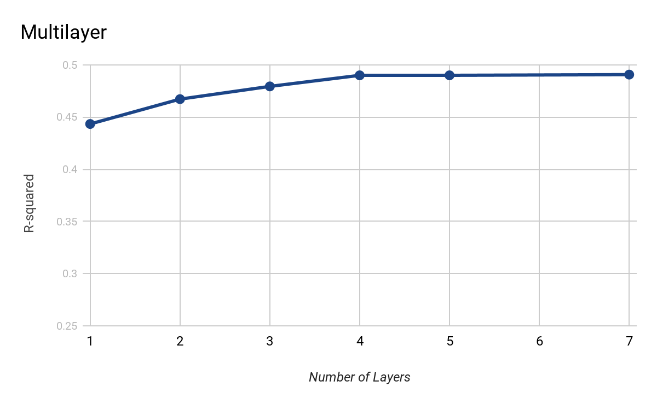
Multilayer
Up to 512 neurons in one layer

Slide 5
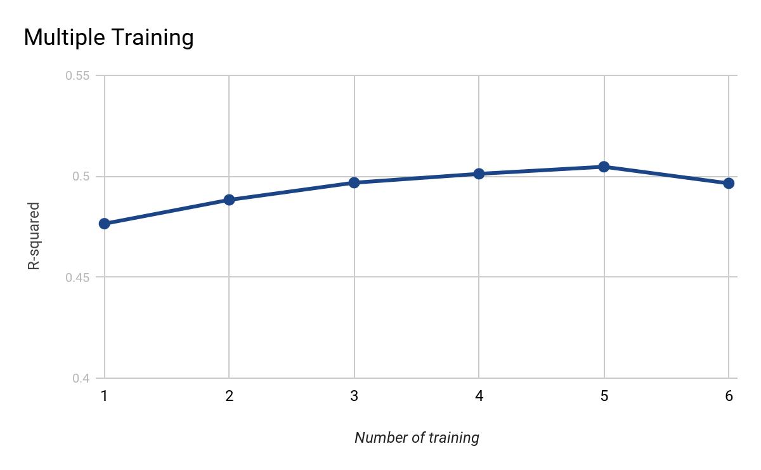
Multiple time training on 5-layer model
Save and retrain the current model

Slide 6
Conclusion and Future Works
5 layer model is the optimal model so far
By retraining model, the R-squared score could be improved
Try different activation layers and scaler to improve prediction

